Slide 1

CannaRec
A recommendation engine for the cannabis industry
Dylan Mendonca

Slide 2
CANNAREC IS A PERSONALIZED STRAIN RECOMMENDATION TOOL FOR THE CANNABIS INDUSTRY
PROVIDES PERSONALIZED RECOMMENDATIONS FOR CANNABIS USERS
IDENTIFY NEW STRAINS BASED ON CURRENT PREFERENCES
FIND NEW STRAINS BASED ON TASTE AND PHYSIOLOGICAL PREFERENCES

Slide 3
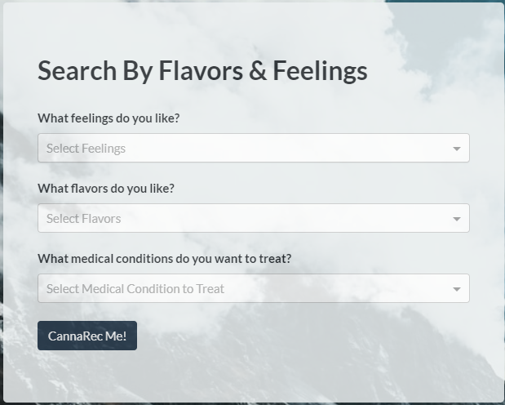
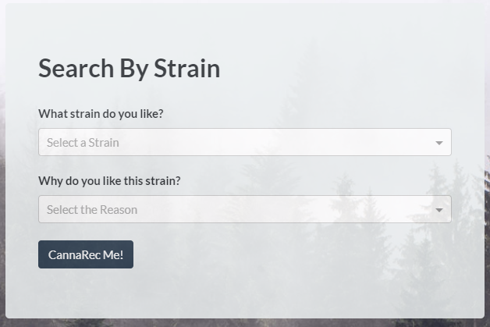
CANNAREC IS A 2-FEATURE FORM-BASED WEB APPLICATION
PERSONAL PREFERENCES TOOL
STRAIN RECOMMENDATION ENGINE

Slide 4


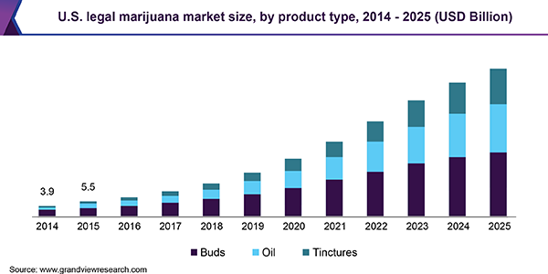
CANNABIS IS AN EXCITING FIELD FOR BIOCHEMICAL ENGINEERS LIKE MYSELF
Large growth potential
Health Benefits
Less harmful than other recreational substances
High opportunity for disruption
Genetic Engineering
Artificial Intelligence
Combines my professional and personal interests ☺

Slide 5

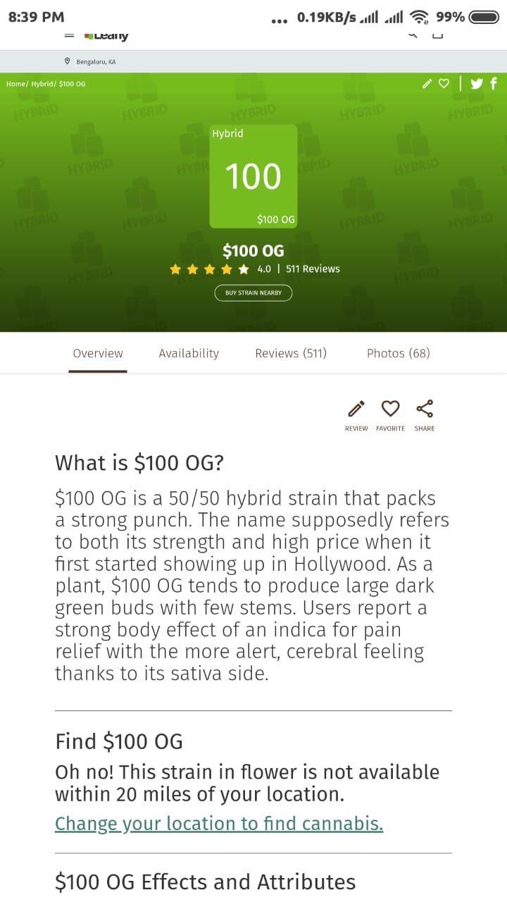
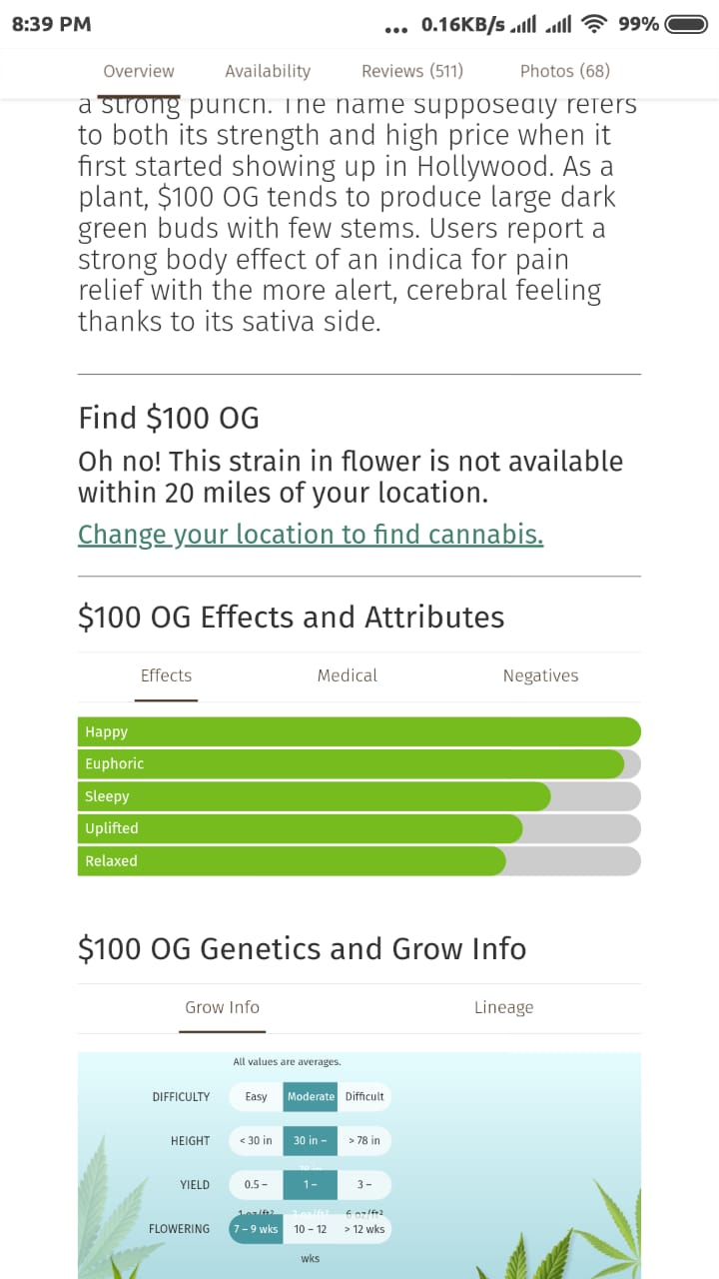
SCRAPED STRAIN INFORMATION FROM LEAFLY’S API
Dataset from Leafly
Scraped the API
Example:
Name: $100 OG
Symbol: 100
Description: $100OG is a 50/50 strain that packs…
URL: https://www.leafly.com/hybrid/100-og
Strain Type: Hybrid
General Effects: {‘Happy’: 100, ‘Euphoric’: 50,…}
Medical Uses: {‘Depression’: 100, ‘Stress’: 50,…}
Flavors: [‘Honey’, ‘Earthy’, ‘Pungent’]

Slide 6
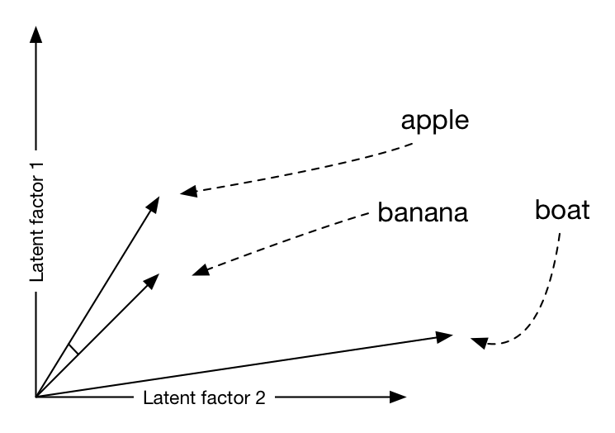
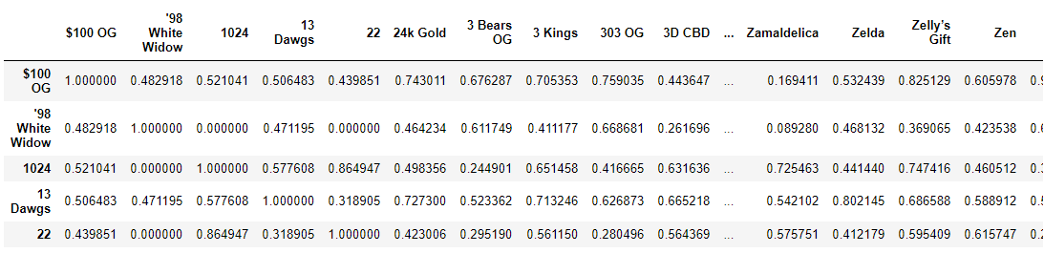
RECOMMENDATION ENGINE WAS BUILT BY MEASURING DISTANCES
Convert each strain into a coordinate
Measure the distance between the coordinates → Similarity Matrix
Cosine Similarity in my case
The smallest distances are the most similar!
Store the similarity matrix

Slide 7
THE PERSONAL PREFERENCES TOOL WAS BUILT BY COMPARING PREFERENCES DESIRED TO THOSE OFFERED BY THE STRAIN
User selects 5 attributes
Strain contains 3 out of the 5 attributes
Strain gets a score of 60%
EXAMPLE:

Slide 8







APPLICATION ARCHITECTURE
Pandas Model
Dash (Flask Server)
Client Form
Similarity Matrices
Strain Table

Slide 9
DEMO

Slide 10
There are a lot of limitations to this application
Dash is not a very scalable web server framework
Transition to Django or Flask
Aesthetic Improvements
The link outs could have nice pop-out effects
Having a small section for data methodology
Model Improvements
Calculating contributions to the similarity score in the recommendation engine
Limitations of the personal preferences model
Backend Improvements
Storing user answers and interaction with website
Data Quality Improvements
Partnership with Leafly
Regulatory Improvements
Age Restriction and Location Verification

Slide 11

Questions?

